Slide 1

Emerging Technologies in computer application for Data collection and Analysis in the field of Environmental Science
GEOLOGICAL SCIENCES
College of Science
University of Texas at El Paso
Geological Science Department
Ceniceros Julio – Masters Research Student
Ziwu Esenam – Masters Research Student

Slide 2
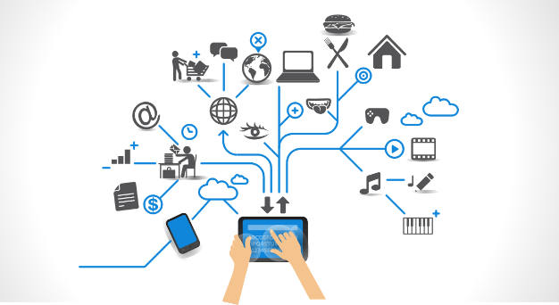
Introduction
We have assessed the current and future state of technology with in our discipline and considered how it relates to our own individual research topics.
Our approach to assessing the discipline into three sections:
Data Management & Collection
Data Integration and Analysis
WS and WF
Visualization

Slide 3
Data Management & Collection
Explanation
Blaschke T, (2010)

Slide 4
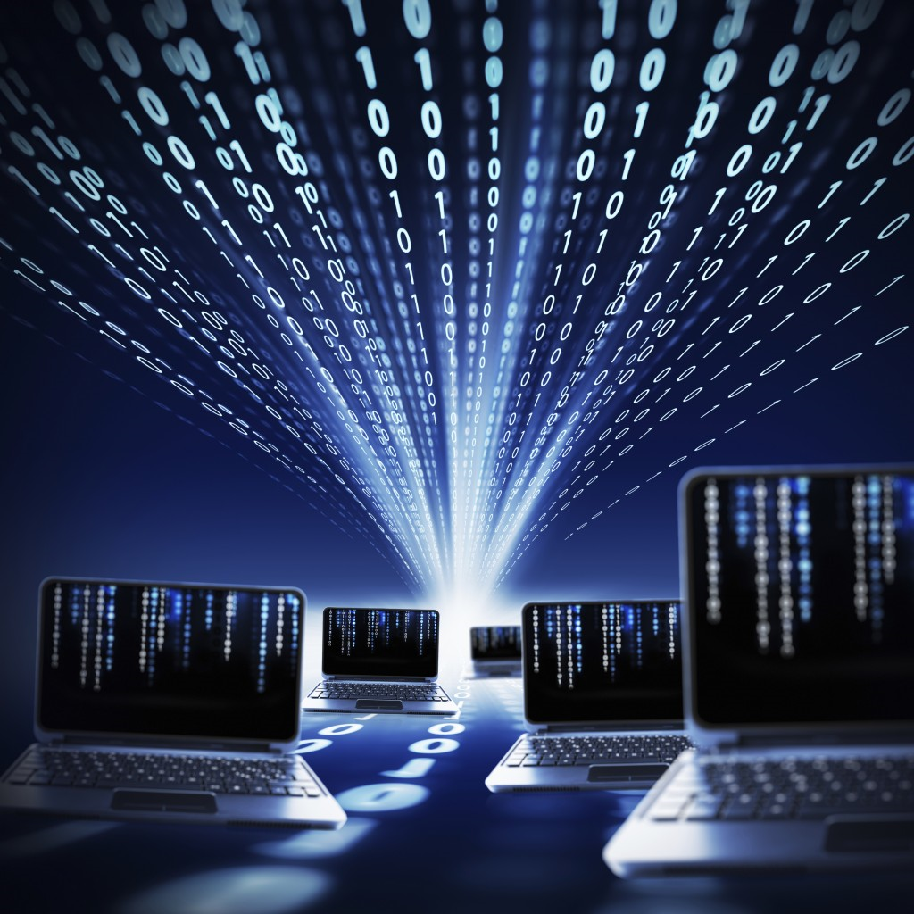
Data Report
Data source technical report
1) Existing technology
The Community Research & Development Information Service (CORDIS) which is funded by the European Commission Program (ECP).
2) Citizen Data
China and Canada example
3) Sensor Networks
TetraScience

Slide 5
Real Example
GitHub
D.A. Roberts, et al., (1998)

Slide 6
Data Integration and Analysis
Data integration involves combining data from various sources and providing users with a unified view of these data. This process becomes extremely useful when it crosses various domains and disciplines and can generate new data from the data links.
Analysis of data, vaguely speaking, is a process of examining, transforming, and visualizing data with the goal of discovering useful information to support results and decision-making.

Slide 7
Report #2
1)Maching learning
IBM Research Lab in South Africa
2) Onthologies
NOAA - Integrated Ocean Observing System (IOOS)
3) Data mining
IBM Analytics???? Find example in Env Science

Slide 8
Real example #2
Weka example

Slide 9
WS and WF
explanation

Slide 10
Report 3
1
2
3

Slide 11
Real Example #3

Slide 12
Visualization
Explanation

Slide 13
Report #4
1
2
3

Slide 14
Real life Example#4

Slide 15
Future

Slide 16
Relevance to our research

Slide 17
Conclusion

Slide 18
Questions?

Slide 19
Citations

